Slide 1
The 18th Degree Certificate
(Certificate of Perfection)
An explanation of its contents with some history and context for the Order

Slide 2
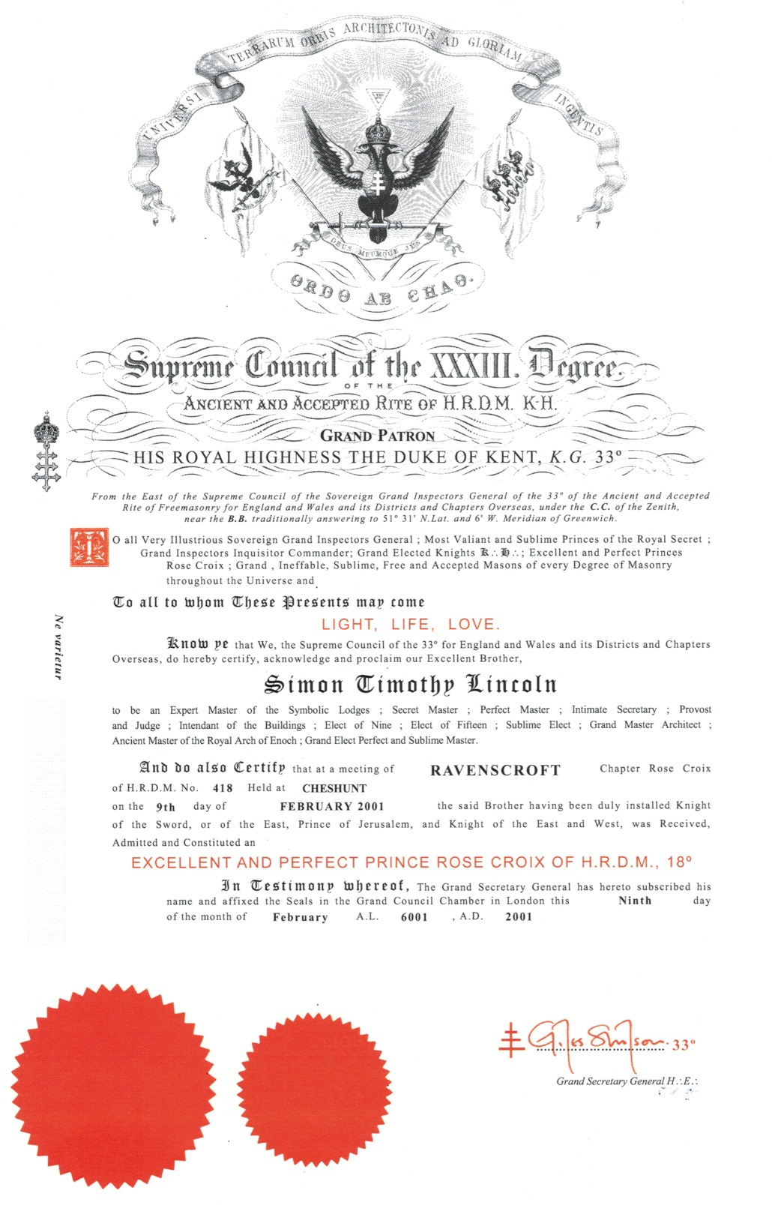

Slide 3
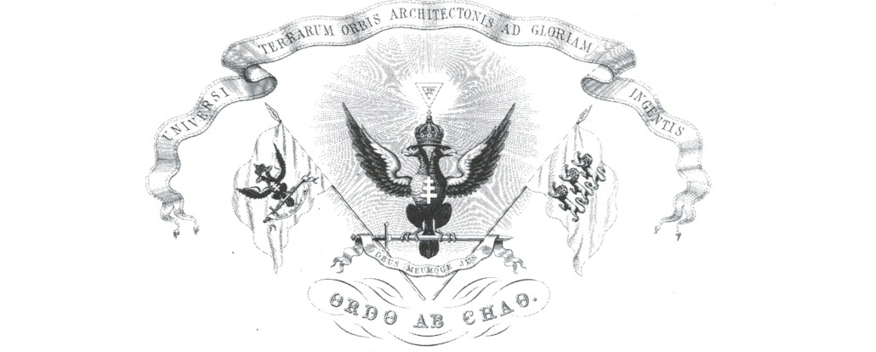
3 lions (leopards) of England
God and my right
To the Glory of the Great Architect of the Universe
Order out of Chaos

Slide 4
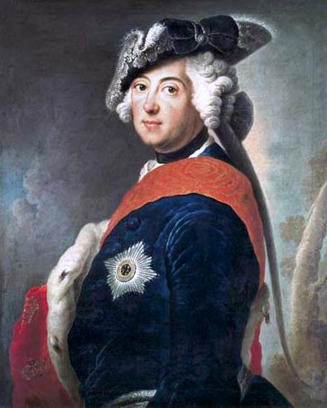
Frederick the Great of Prussia
Holy Roman Emperor
Order out of chaos
Grand Constitutions of 1786

Slide 5
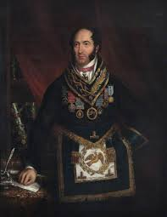
Dr. Robert Thomas Crucefix
Letters Patent in October 1845

Slide 6


Slide 7
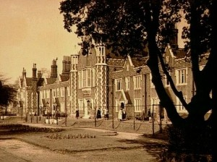
The Asylum for Worthy, Aged and Decayed Freemasons
Grand Lodge inaugurated the Royal Masonic Benevolent Annuity Fund for men in 1842 and the Female Annuity Fund in 1849. The following year, 1850, the first Home was opened in East Croydon
Notes:
This was the first home of what would become the RMBI and the title shows that they called a spade a spade in those days!

Slide 8
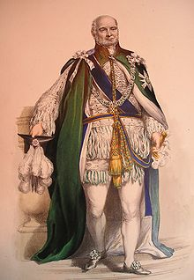
Prince Augustus Frederick,
Duke of Sussex
Appointed Grand Master of the Premier Grand Lodge of England –
January 1813
Grand Master United Grand Lodge of England –
December 1813 - 1843

Slide 10
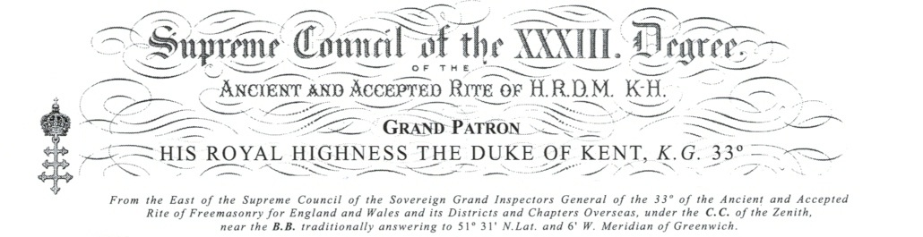

Slide 11
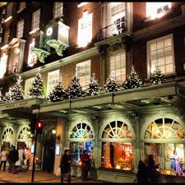
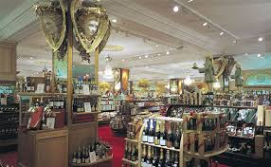
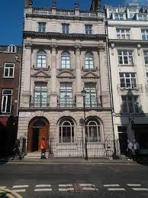
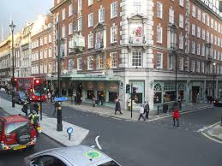

Slide 12
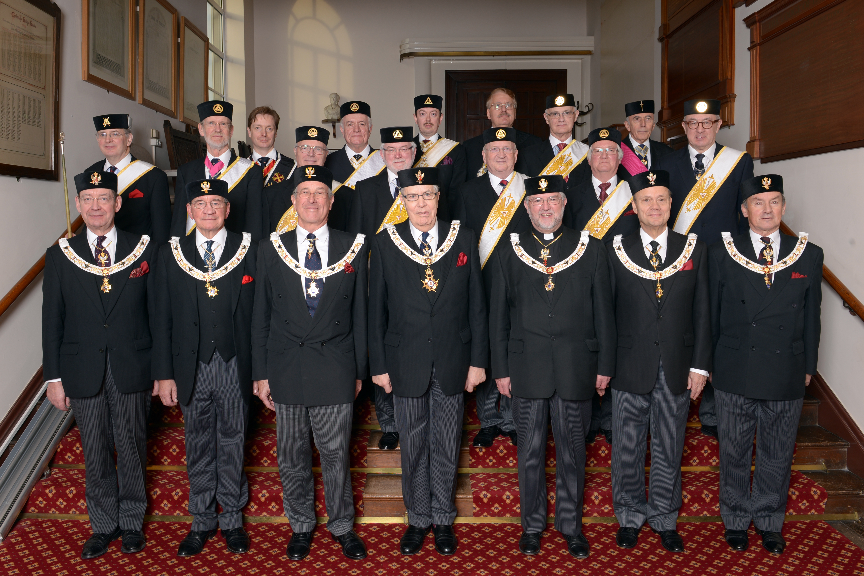
The Supreme Council 33rd Degree for England and Wales and its Districts & Chapters overseas

Slide 13
The Supreme Council 33rd Degree for England and Wales and its Districts & Chapters overseas

Slide 14
The Supreme Council 33rd Degree for England and Wales and its Districts & Chapters overseas
9 members
50+ Districts
Meet monthly
The Supreme Council 33rd Degree
for The Northern Jurisdiction of the U.S.A.
66 members
15 States
Meet annually

Slide 15
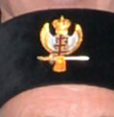
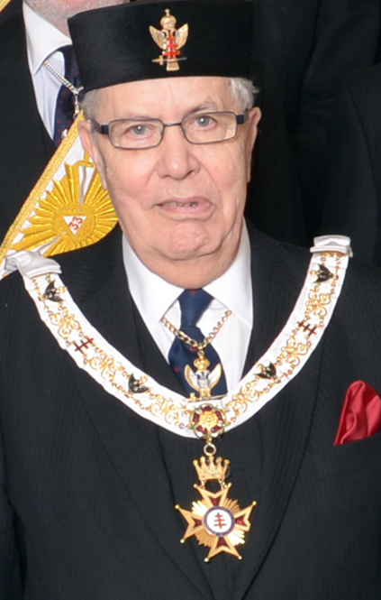

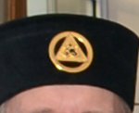

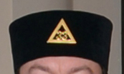

Slide 16
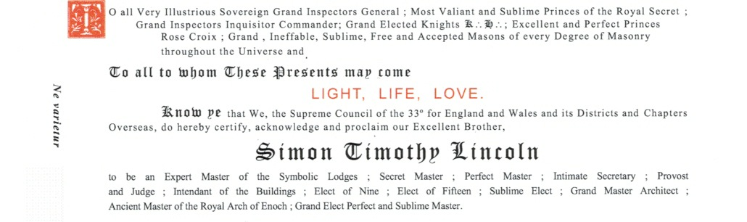

Slide 17
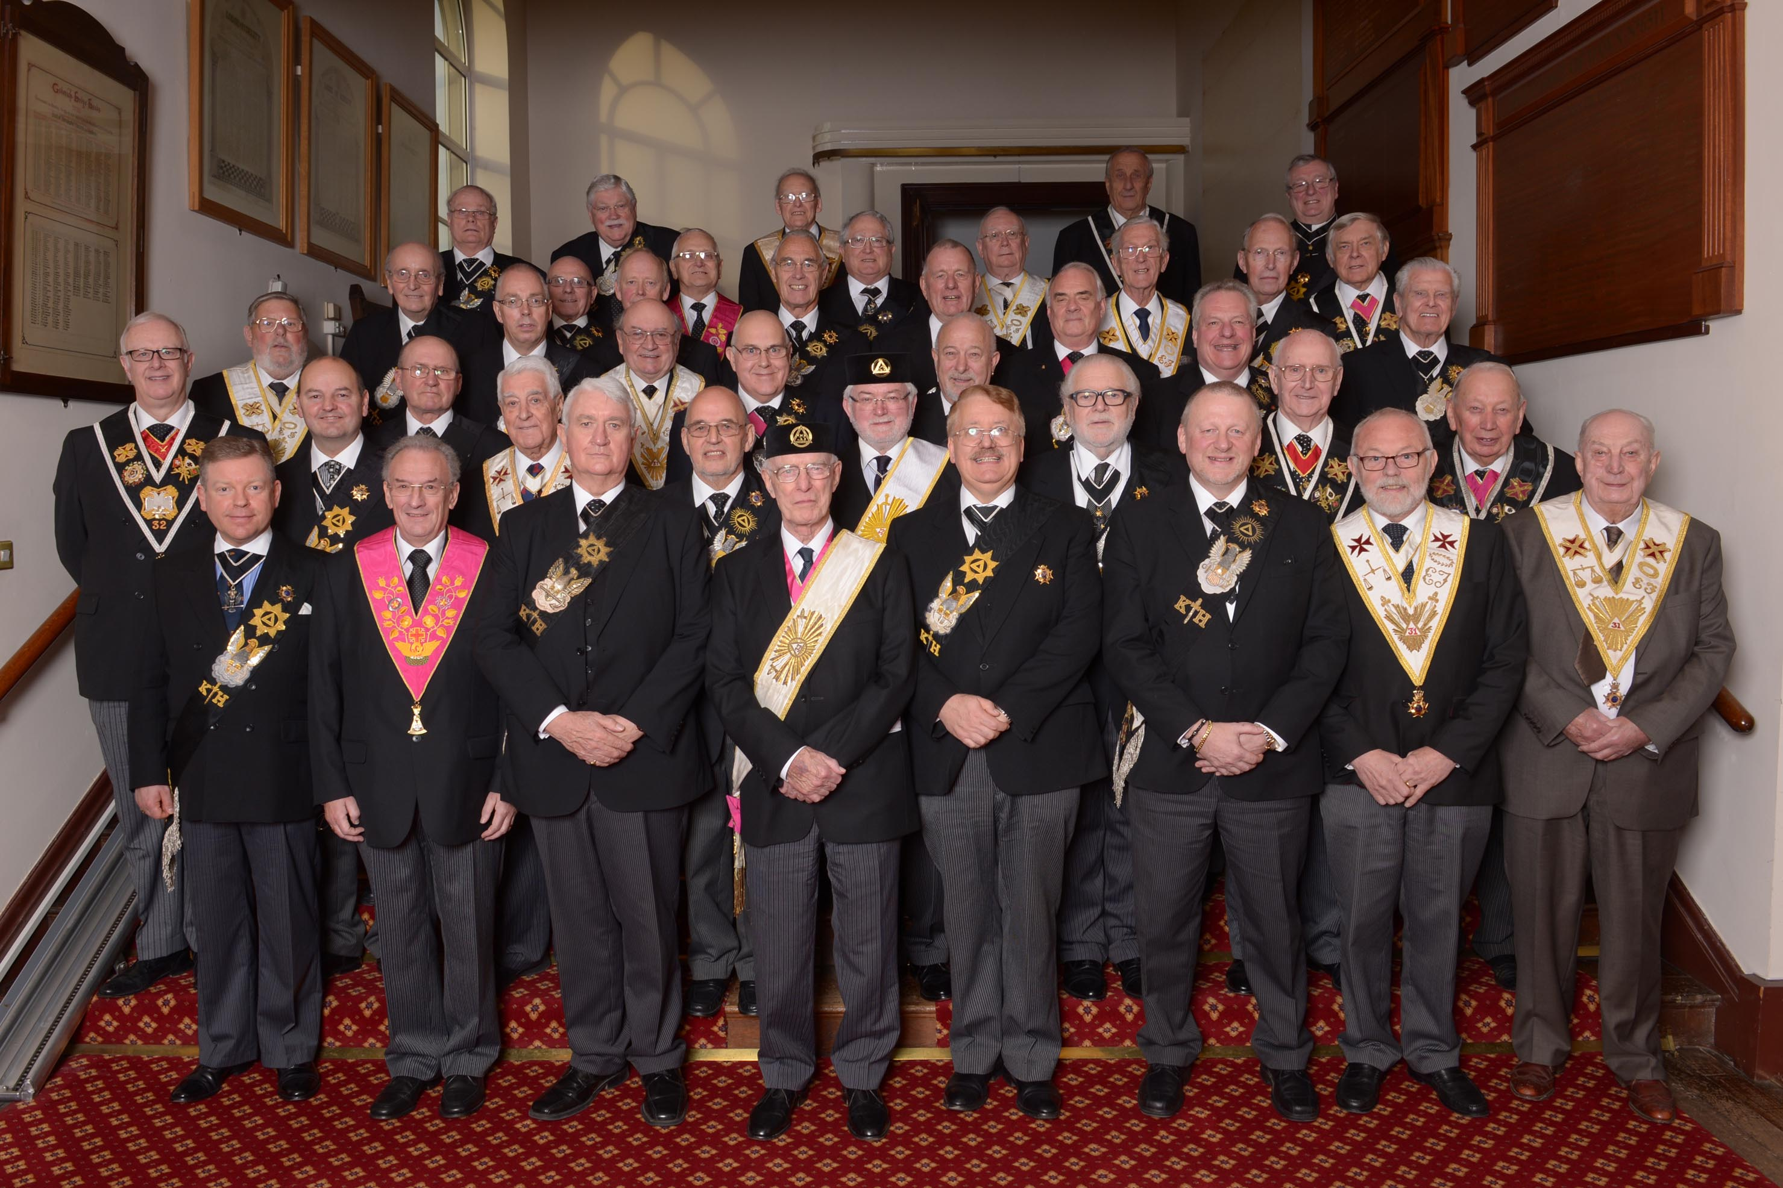
Very Illustrious Sovereign Grand Inspectors General - 33°
Most Valiant & Sublime Princes of the Royal Secret -32°
Grand Inspectors Inquisitor Commander - 31°
Grand Elected Knights Kadosh - 30°
Excellent & Perfect Princes Rose Croix - 18°

Slide 19
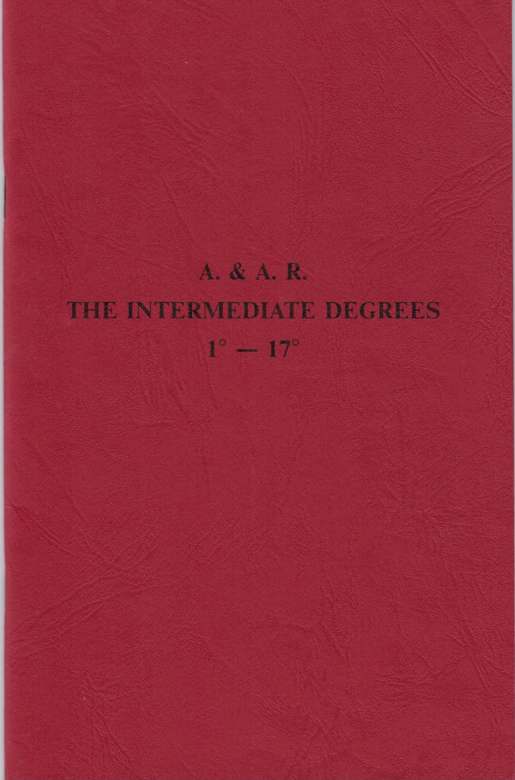

Slide 20
Intermediate Degrees
4th Secret Master
5th Perfect Master
6th Intimate Secretary
7th Provost and Judge
8th Intendant of the Buildings
9th Elect of Nine
10th Elect of Fifteen
11th Sublime Elect
12th Grand Master Architect

Slide 21
Intermediate Degrees
13th Royal Arch of Enoch
14th Grand Elect Perfect and Sublime Master
15th Knight of the Sword or of the East
16th Prince of Jerusalem
17th Knight of the East and West

Slide 22
